Slide 1
Checking understanding of area
Perimeter, area and volume

Slide 2
how to use Oak lessons

Slide 3
I can find the area of triangles, quadrilaterals and composite rectilinear shapes.

Slide 4
The area is the size of the surface and states the number of unit squares needed to completely cover that surface.
A trapezium is a quadrilateral with exactly one pair of parallel opposite sides. The plural of trapezium can be referred to as trapezia or trapeziums.
A composite rectilinear shape is a composite shape made from rectangles.

Slide 5

Checking understanding of area
Areas of rectangles, triangles and parallelograms
Areas of trapezia
Areas of composite shapes

Slide 6
Areas of rectangles, triangles and parallelograms
The rectangle below represents a field that is surrounded by a wall.
Which could be found by calculating the area of the field: the total amount of grass or the total length of wall?
The area of the field is the amount of space covered with grass.
90 m
area = 10800 m²
120 m

Slide 7
Areas of rectangles, triangles and parallelograms
Area is the amount of 2D space that is taken up by a shape.
Finding the area of a shape always involves multiplying together two perpendicular lengths somewhere within the calculation.
Area is measured in square units.
Examples of units:
km², m², cm², mm²
miles², feet², inches²

Slide 8
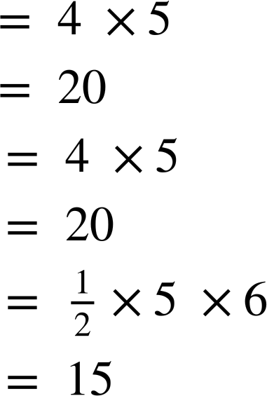
Areas of rectangles, triangles and parallelograms
There are different formulae for calculating areas, which all include a multiplication of two perpendicular lengths.
Example: find the area of each shape.
7
5
6
5
5
4
4
6
area = width × length
area = base × height
area = × base × height
units²
units²
units²

Slide 9

Areas of rectangles, triangles and parallelograms
Which is the formula to calculate the area of a triangle?
area = base × height
area = × base × height
area = width × length

Slide 10
Areas of rectangles, triangles and parallelograms
You can calculate the area of the parallelogram by multiplying together a and b .
a
b
You need to multiply together two lengths to find an area.
A calculation for area must include the multiplication of two perpendicular lengths.

Slide 11
Areas of rectangles, triangles and parallelograms
Which two calculations could be used to calculate the area of the parallelogram?
a × c
a
c
a × d
d
b × c
b
b × d

Slide 12
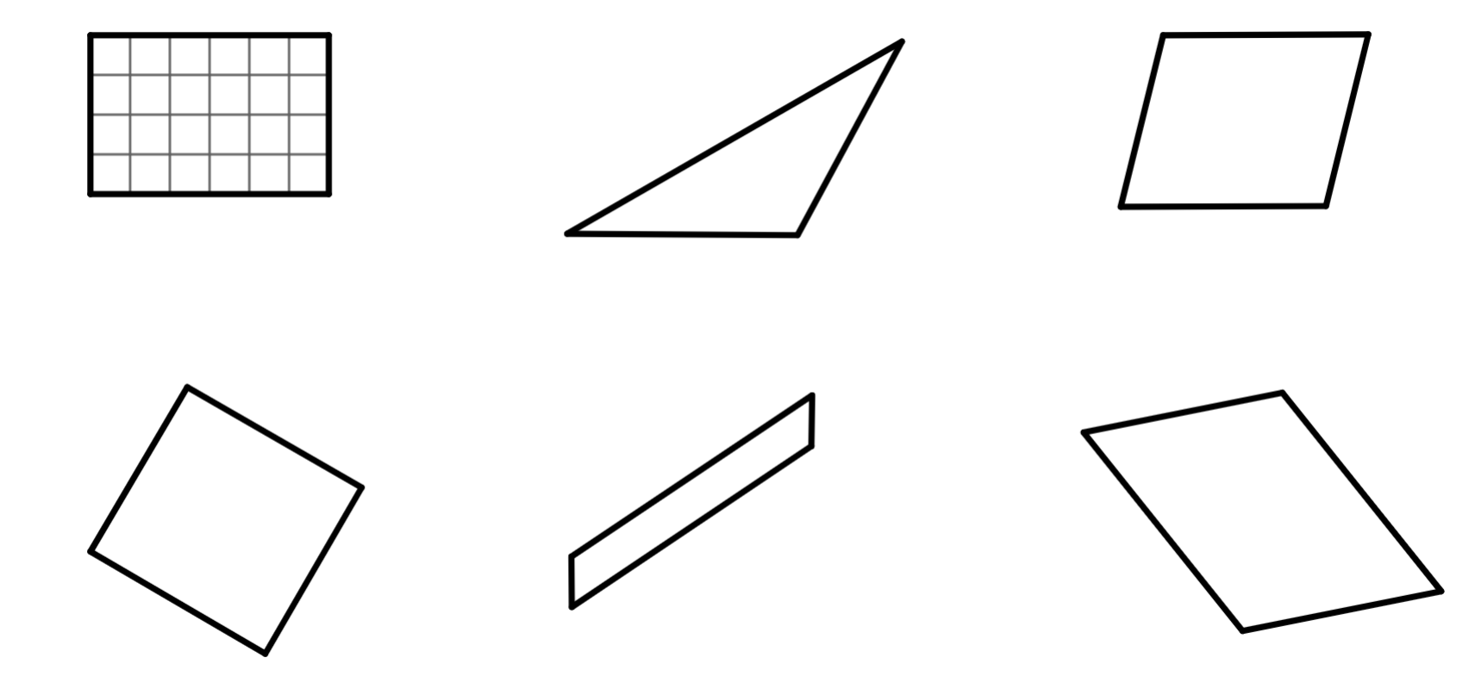
Areas of rectangles, triangles and parallelograms
Find the area of each shape.
a)
b)
c)
7 cm
10 cm
9 cm
4 cm
11 cm
5 cm
area = units²
area = cm²
area = _
d)
e)
15 cm
f)
8 mm
4.5 m
1 cm
12 m
8 mm
9 mm
9 m
18 cm
6 m
area = _
area = _
area = _

Slide 13
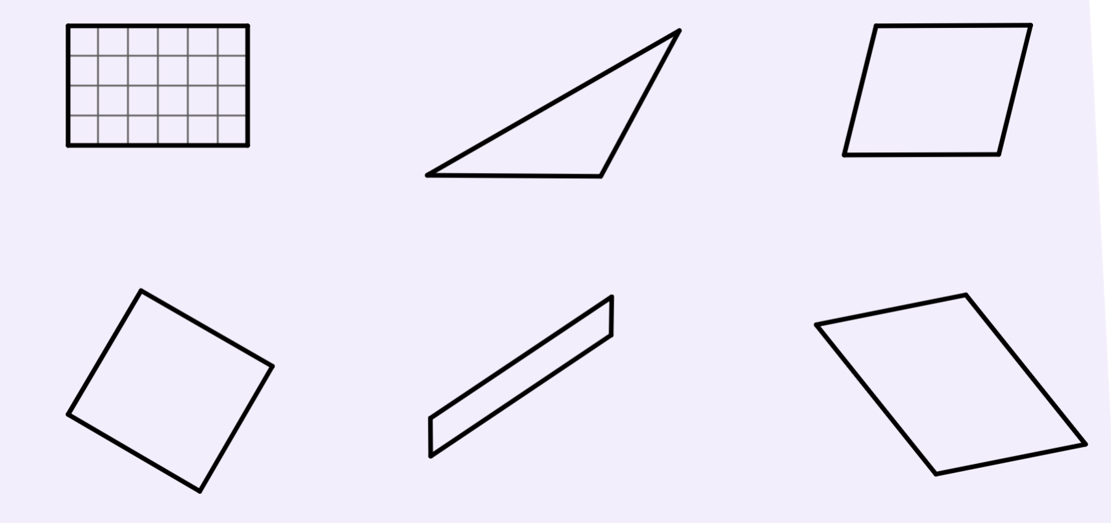
Areas of rectangles, triangles and parallelograms
Find the area of each shape.
a)
b)
c)
7 cm
10 cm
9 cm
4 cm
11 cm
5 cm
24
10
90 cm²
area = units²
area = cm²
area =
d)
e)
15 cm
f)
8 mm
4.5 m
1 cm
12 m
8 mm
9 mm
9 m
18 cm
6 m
64 mm²
15 cm²
54 m²
area =
area =
area =

Slide 14
Checking understanding of area
Areas of rectangles, triangles and parallelograms
Areas of trapezia
Areas of composite shapes

Slide 15
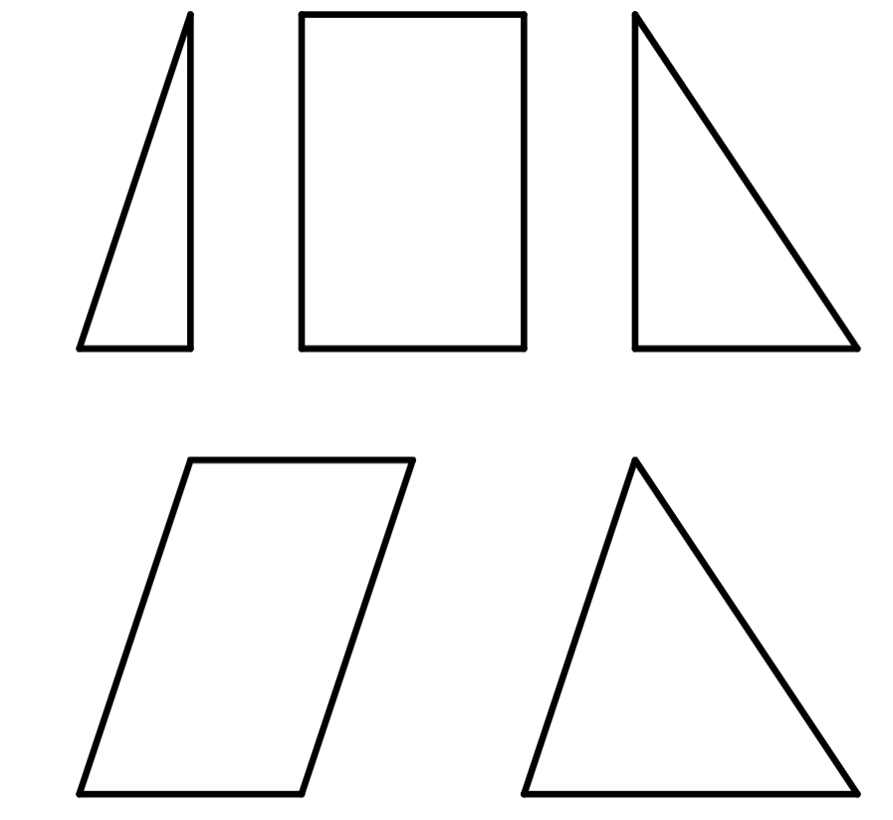
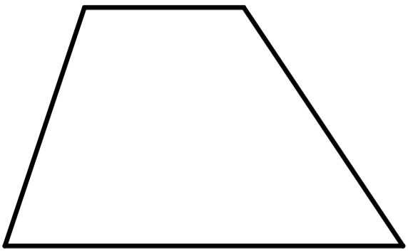
Areas of trapezia
Find the area of each shape.
4
6
6
2
4
4
10
6 units²
+
24 units²
+
12 units²
=
42 units²
The shapes combine to make a trapezium.
Find the total area of the trapezium.

Slide 16
Areas of trapezia
Find the area of each shape.
4
4
6
6
6
10
24 units²
+
18 units²
=
42 units²
The shapes combine to make a trapezium.
Find the total area of the trapezium.

Slide 17
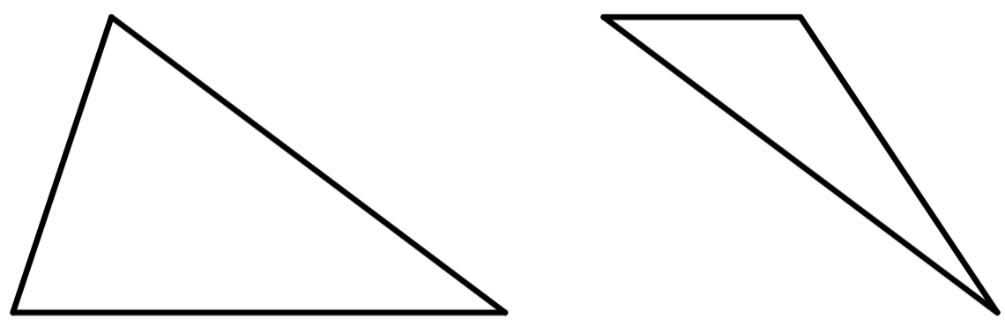
Areas of trapezia
Find the area of each shape.
4
4
6
6
10
10
30 units²
+
12 units²
=
42 units²
The shapes combine to make a trapezium.
Find the total area of the trapezium.

Slide 18
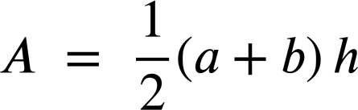
Areas of trapezia
Areas of trapezia can be calculated by splitting into other shapes.
+
+
+
+
+
b
There is also a formula:
h
Where a and b are the parallel sides.
a

Slide 19
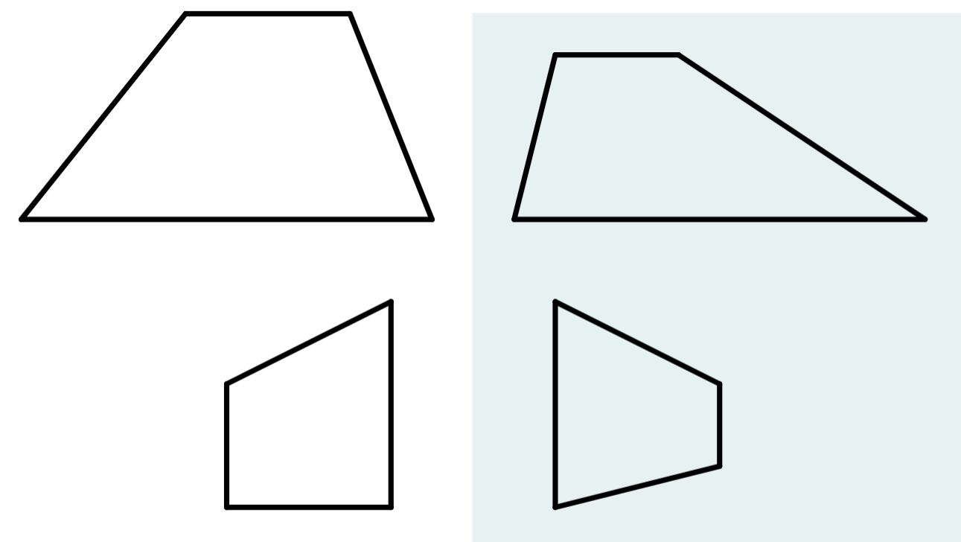
Areas of trapezia
Find the area of the trapezium by splitting it into smaller shapes.
Find the area of the trapezium by splitting it into smaller shapes.
4
3
5
4
A
B
C
10
10
4
4
B
5
5
A
C
3
7
4
12 units²
+
14 units²
=
26 units²
6
20 units²
+
15 units²
=
35 units²

Slide 20
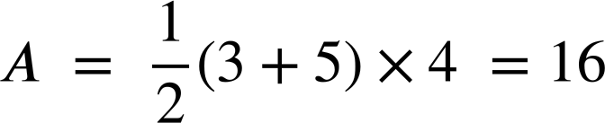
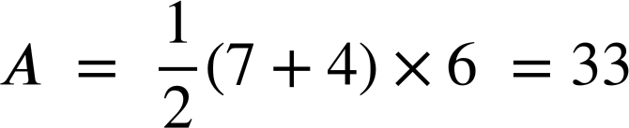
Areas of trapezia
Find the area of the trapezium by using the formula.
Find the area of the trapezium by using the formula.
5
7
4
3
4
6
units²
units²

Slide 21
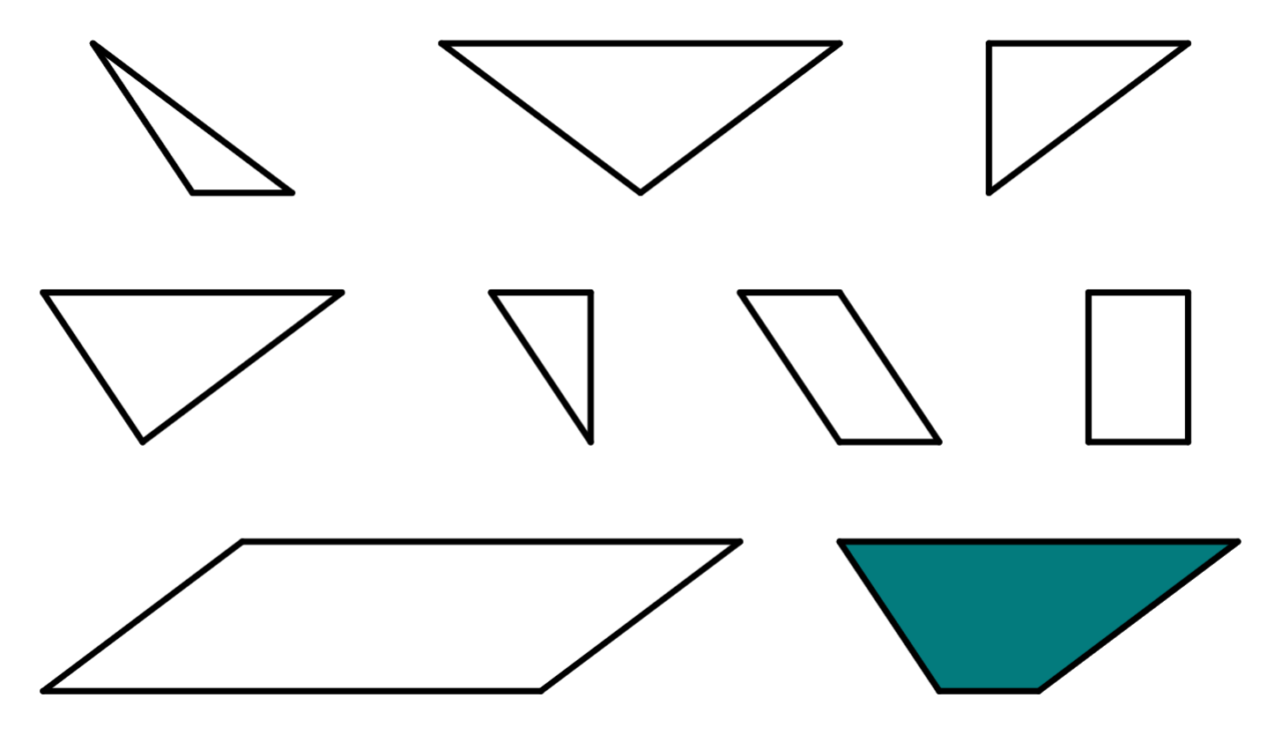
Areas of trapezia
1) The letters inside each shape represents its area.
a) Use each letter once to fill in the gaps in the calculations. Multiple solutions exist.
2
T = + +
F
T
3
A
3
T = +
8
10
T = +
3
B
3
C
3
E
3
T = ÷ 2
D
2
2
2
6
2
b) Find the value of T.
3
3
H
F
G
3
T = units²
4
8

Slide 22
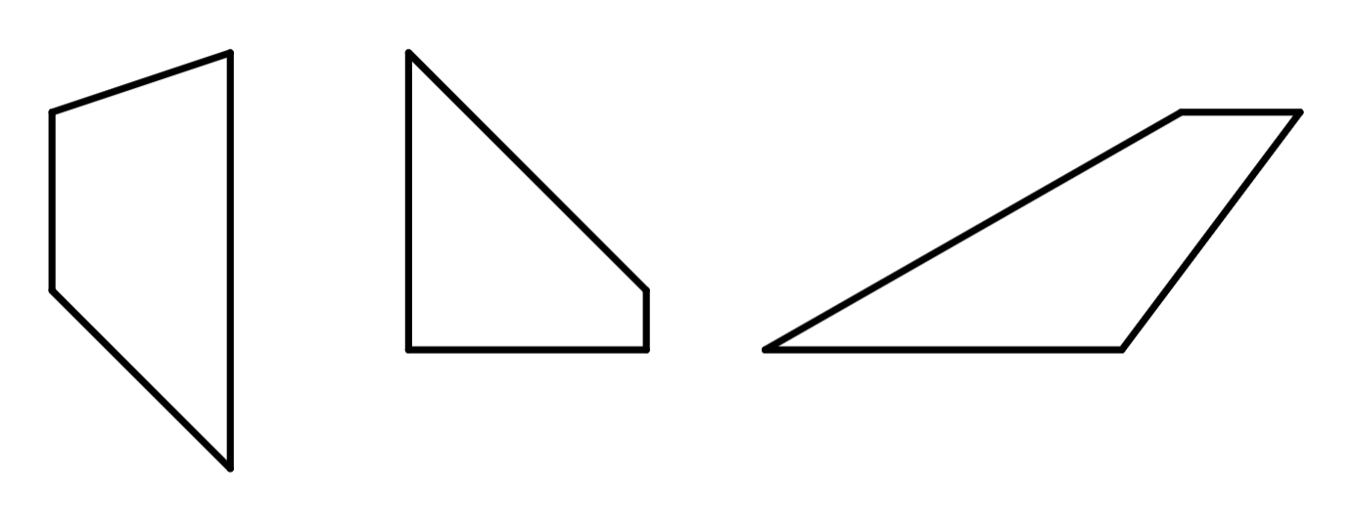
Areas of trapezia
2) All of the shapes below are trapezia.
Use the formula or any other method to calculate the area of each
trapezium.
For a trapezium with parallel sides a and b:
a)
6 cm
b)
c)
5 cm
7 cm
4 cm
4 cm
3 cm
1 cm
3 cm
2 cm
4 cm
4 cm

Slide 23
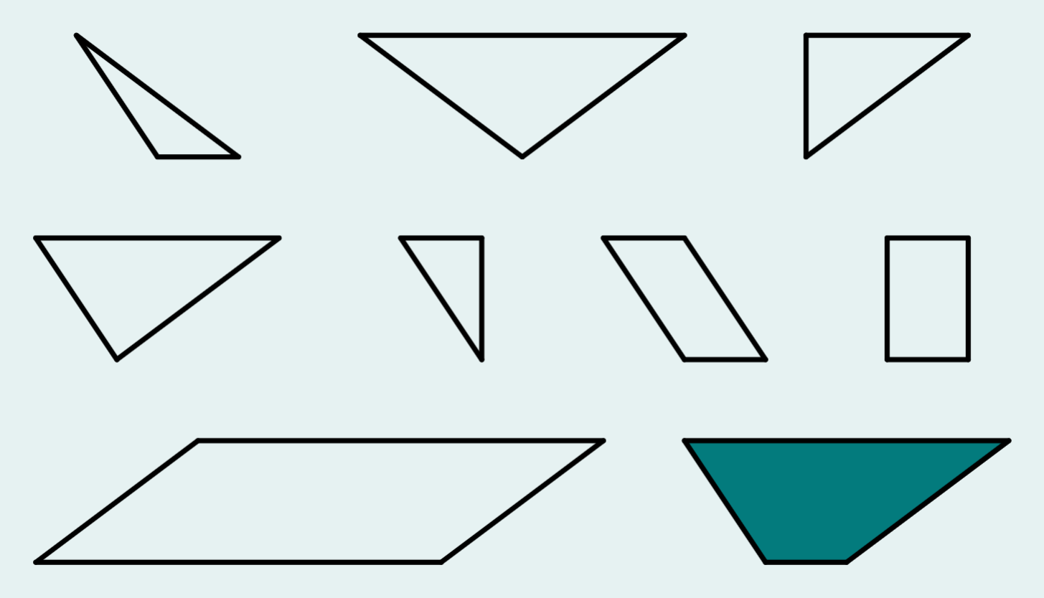
Areas of trapezia
1) The letters inside each shape represents its area.
a) Use each letter once to fill in the gaps in the calculations. Multiple solutions exist.
Possible solution:
2
T
3
A
3
T = + +
F
B
D
8
10
T = +
C
E
G
3
B
3
C
3
E
3
T = +
H
D
T = ÷ 2
2
2
2
6
A
2
F
3
G
3
H
3
4
8

Slide 24
Areas of trapezia
1) The letters inside each shape represents its area.
a) Use each letter once to fill in the gaps in the calculations. Multiple solutions exist.
Alternative solution:
2
T
3
A
3
T = + +
F
C
D
8
10
T = +
B
E
G
3
B
3
C
3
E
3
T = +
H
D
T = ÷ 2
2
2
2
6
A
2
For other alternatives, find the area of each shape and check that all the calculations give 15.
F
3
G
3
H
3
4
8

Slide 25
Areas of trapezia
2
b) Find the value of T.
15
T
3
A
3
T = units²
8
10
3
B
3
C
3
E
3
D
2
2
2
6
2
F
3
G
3
H
3
4
8

Slide 26
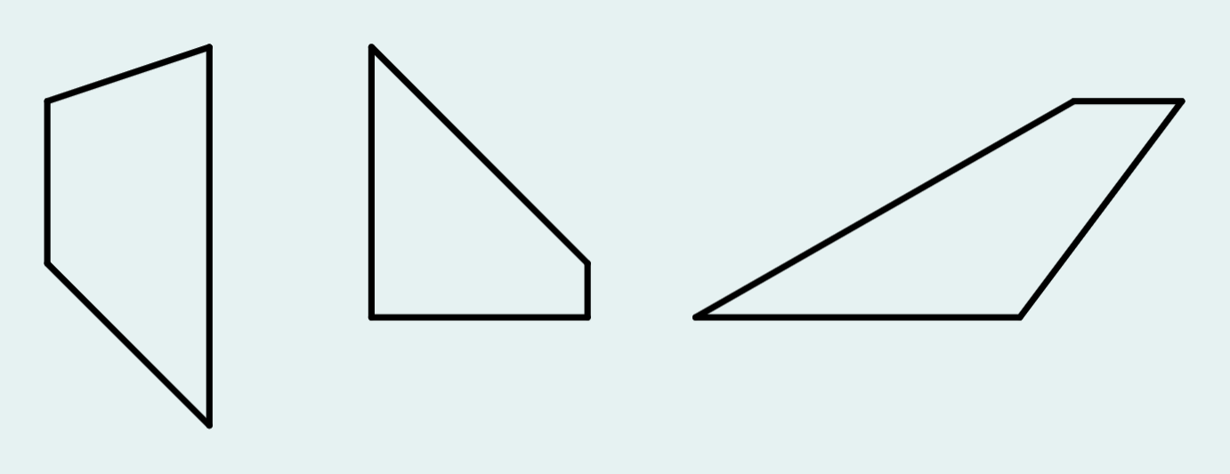
Areas of trapezia
2) All of the shapes below are trapezia.
Use the formula or any other method to calculate the area of each
trapezium.
For a trapezium with parallel sides a and b:
a)
6 cm
b)
c)
5 cm
7 cm
4 cm
4 cm
3 cm
1 cm
3 cm
2 cm
4 cm
4 cm
16 cm²
10 cm²
15 cm²

Slide 27
Checking understanding of area
Areas of rectangles, triangles and parallelograms
Areas of trapezia
Areas of composite shapes

Slide 28
Areas of composite shapes
Areas of composite shapes can be found by splitting them into shapes whose area can be found.
2
2
3
3
8
4
5
5
6
6
6 units²
+
30 units²
= 36 units²

Slide 29
Areas of composite shapes
Areas of composite shapes can be found by splitting them into shapes whose area can be found.
2
2
3
3
8
4
8
4
5
5
6
6
11 units²
+
25 units²
= 36 units²

Slide 30
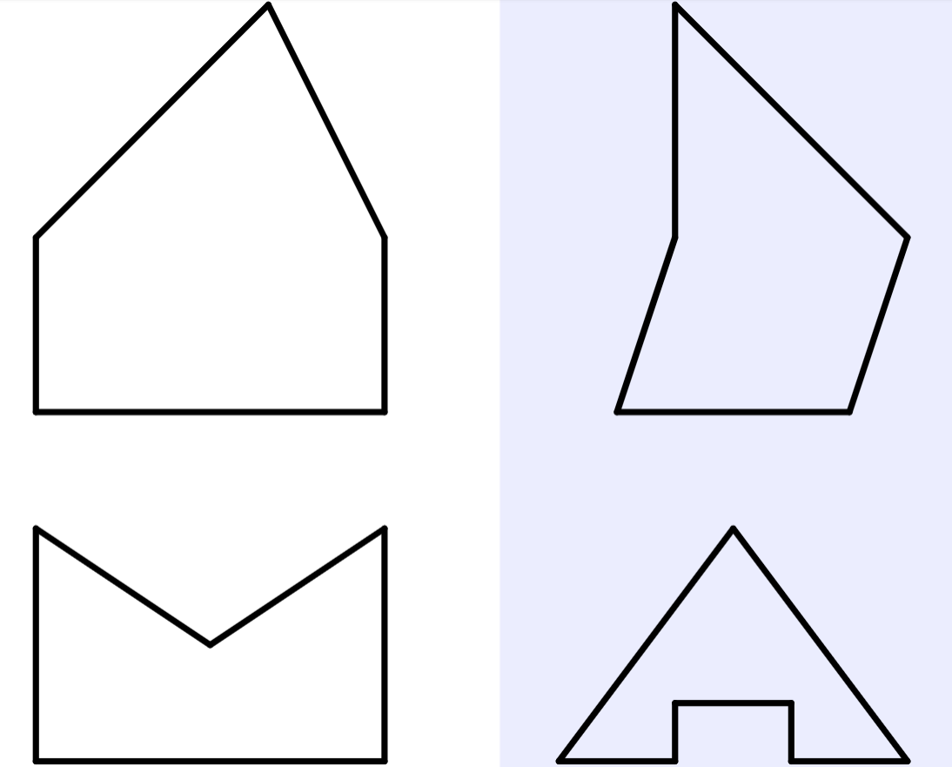
Areas of composite shapes
Find the area.
Find the area.
4 cm
A
A
7 cm
7 cm
B
B
3 cm
4 cm
6 cm
4 cm
B
4 cm
A
3 cm
A
B
3 cm
4 cm
4 cm
6 cm
6 cm
12 cm²
+
18 cm²
= 30 cm²
8 cm²
+
12 cm²
= 20 cm²

Slide 31
Areas of composite shapes
Find the area.
Find the area.
5 m
4 m
3 m
3 m
2 m
6 m
6 m
6 m
2 m
5 m
4 m
1 m
6 m
6 m
2 m
30 m²
−
6 m²
= 24 m²
12 m²
−
2 m²
= 10 m²

Slide 32
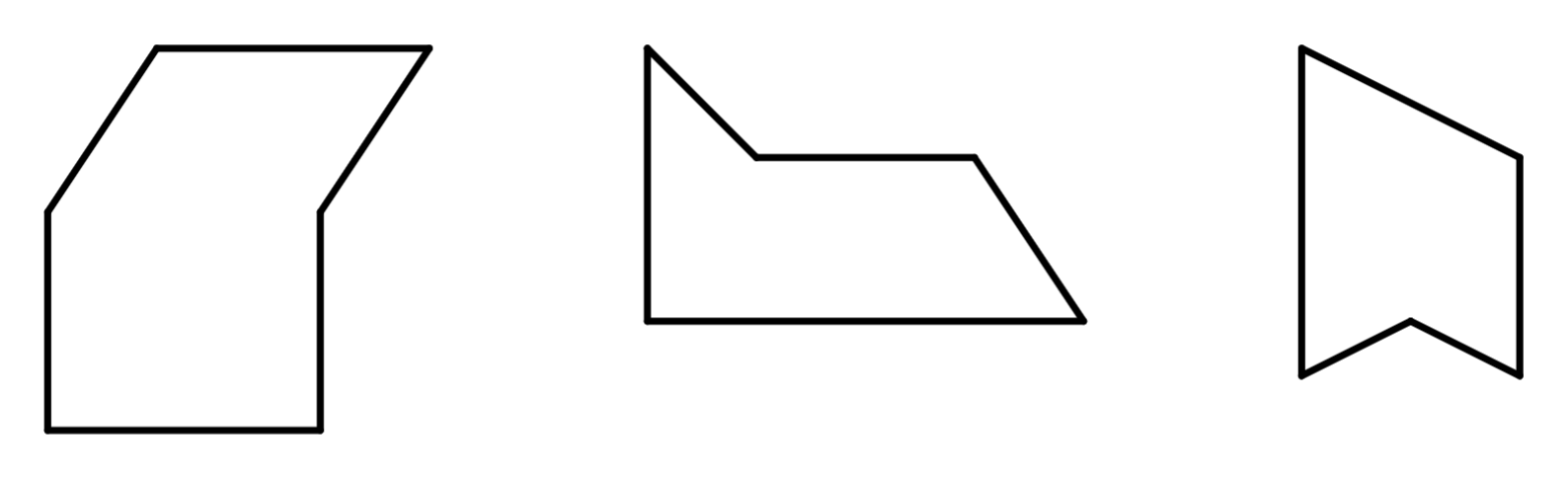
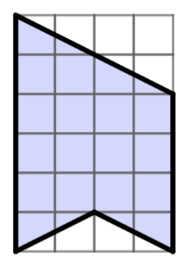
Areas of composite shapes
1) Find the area of each composite shape.
a)
b)
c)
1 cm
2 mm
1 cm
4 mm
5 mm
7 cm
3 mm
4 cm
8 mm
5 cm

Slide 33
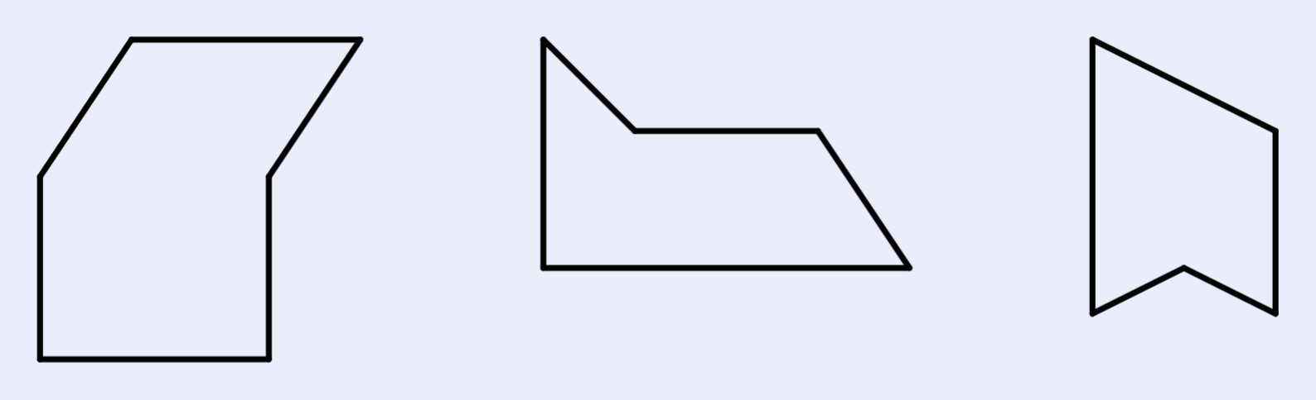
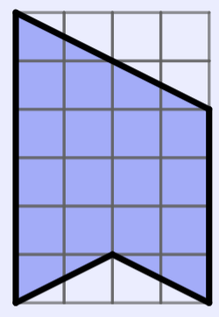
Areas of composite shapes
1) Find the area of each composite shape.
a)
b)
c)
1 cm
2 mm
1 cm
4 mm
5 mm
7 cm
3 mm
4 cm
8 mm
5 cm
35 cm²
23 mm²
18 cm²

Slide 34
Checking understanding of area
The area is the size of the surface and states the number of unit squares needed to completely cover that surface. A formula can be used to find the area of a rectangle, triangle or parallelogram. There can be more than one way to find the area of a trapezium. The area of composite shapes can be found by splitting them into shapes whose area can be found.

Slide 35

© Oak National Academy 2023.
Produced in partnership with Mathematics in Education and Industry.
Licensed on the Open Government Licence v3.0, except where otherwise stated. See Oak terms and conditions.

